Slide 1
Algorithms for the Visualization and Simulation of Mobile Ad Hoc and Cognitive Networks
Dan Hennessey

Slide 2
Outline
Introduction
Mobile Ad Hoc Network Visualization
Simplification Algorithm for Visualizing the Structure of Complex Graphs
GPU Based Algorithms for Spectrum Sensing in Cognitive Networks.
Conclusions

Slide 3
Introduction
Give a brief into about the topics being discussed.
Use the abstract as a guide for this section

Slide 4
Algorithms for Mobile Ad Hoc Network Visualization
Chapter 1

Slide 5
Mobile Ad Hoc Networks
Cover the motivation behind the visualization efforts
Use the related work section to explain lack of useful visualization techniques
No uses of digital terrain for improving the visual representation of MANETs

Slide 6
Signal Radiation Patterns
Explain the signal radiation patterns
Explain what they represent and why they are useful to visualize
Possibly use the equations to help with this

Slide 7
Radiation Patterns
Fully known channel state
Highly unstable channel state

Slide 8
Radiation Patterns with Regions of Acceptable SINR
Fully known channel state
Highly unstable channel state

Slide 9
Digital Terrain
Motivate use of digital terrain
Uses in both simulation and visualization
Needed to develop a library to abstract the specifics of file formats.

Slide 10
Terrain Library
Don’t cover entire design of the terrain library
Cover specific features
Like lake detection
Horizontal cut profiles
How it removes file boundaries
Its abstract way of referencing terrain data

Slide 11
Terrain Color Maps

Slide 12
2D Terrain Visualization
Flow Graph
Physical Graph

Slide 13
3D Terrain Visualization

Slide 14
3D Terrain Visualization

Slide 15
Conclusion
Brief summary of conclusions
Use conclusion summary from paper as guide

Slide 16
A Simplification Algorithm for Visualizing the Structure of Complex Graphs
Chapter 2

Slide 17

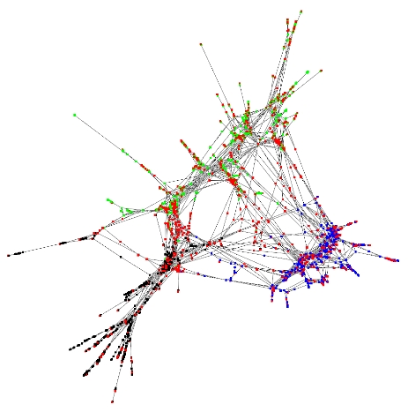
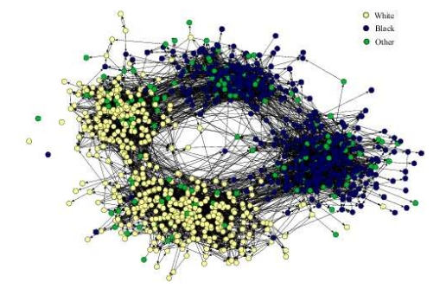
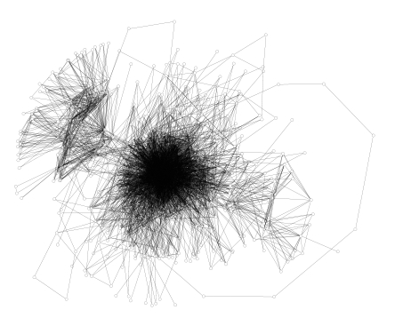
Notes:
17

Slide 18

Node weighting
N-ring Neighbors
Number of Shortest Paths
Eccentricity
Shortest Distance to a Center Node
Shortest Distance to a Leaf Node
Node Pruning
Connectivity Preservation
Iterative Pruning
Notes:
18

Slide 19

3 Performance Criteria
Wide range of weight values
Even distribution of weights
Meaningful visual representation
Notes:
19

Slide 20

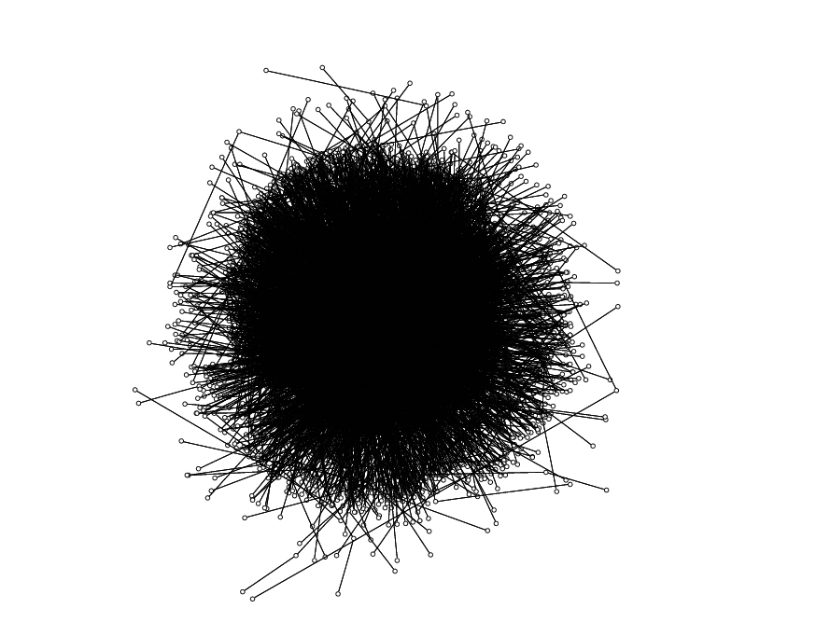
4500 Nodes
15308 Edges
Notes:
20

Slide 21

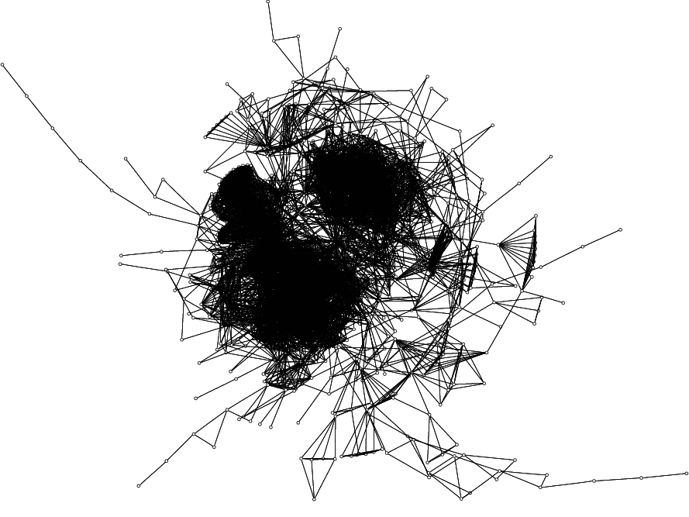
1025 Nodes
15430 Edges
Notes:
21

Slide 22

Notes:
22

Slide 23


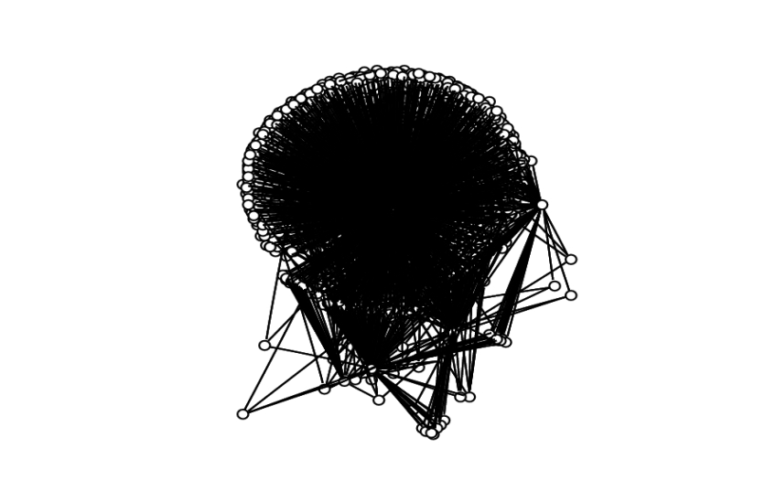
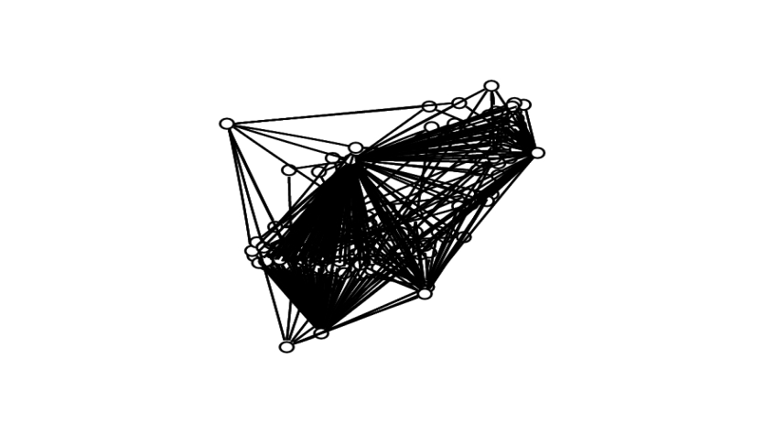
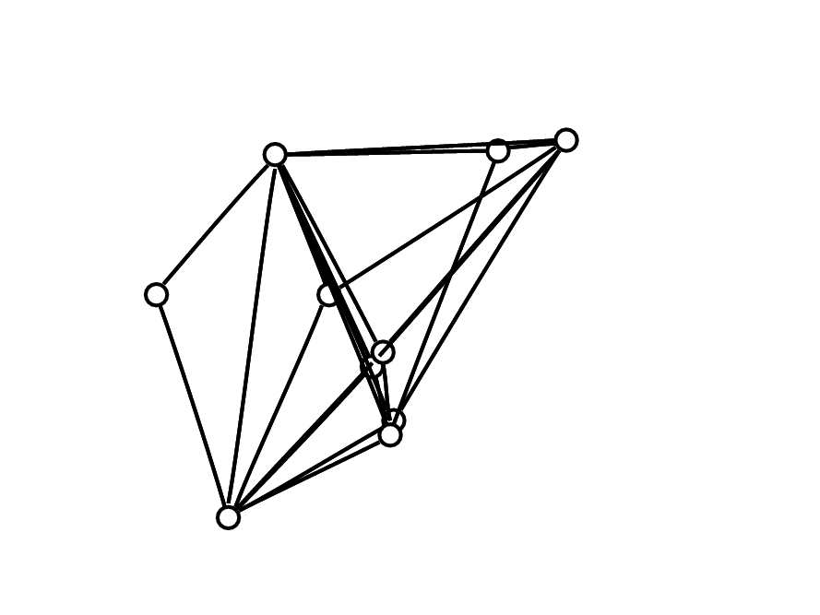
T = 300
T = 700
T = 1200
T = 1800
Notes:
23

Slide 24

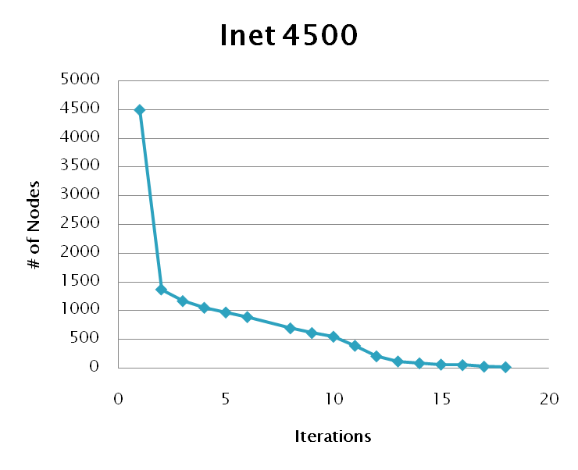
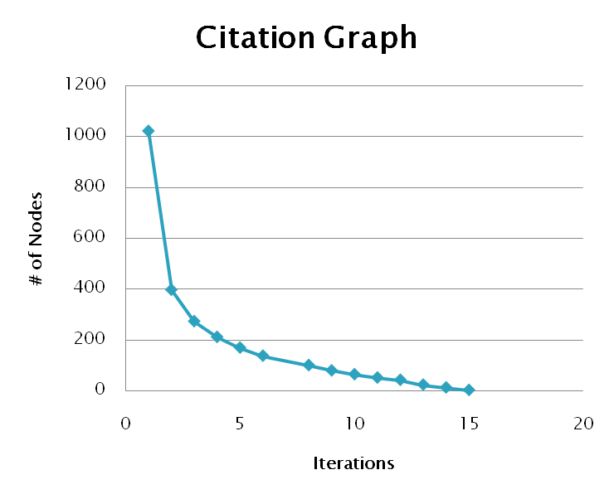
Notes:
24

Slide 25

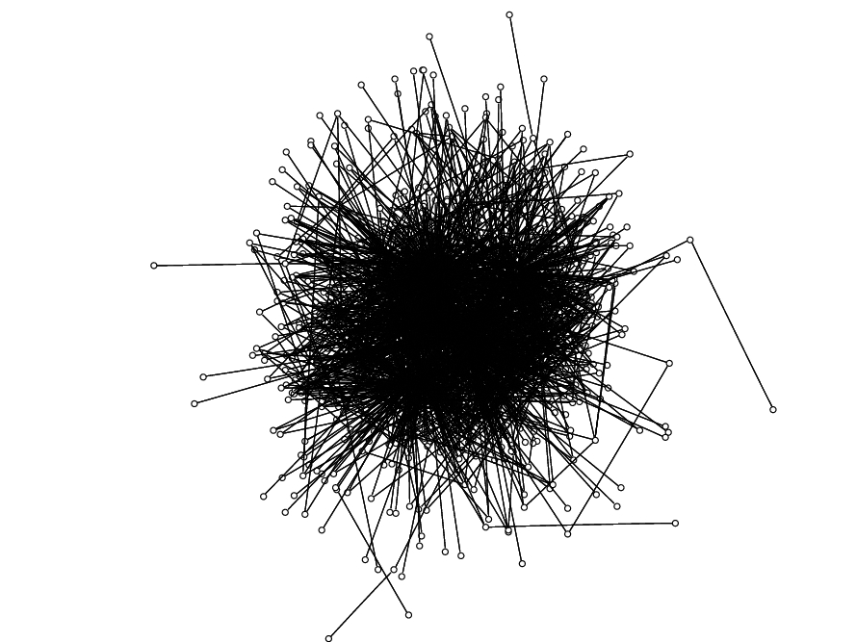
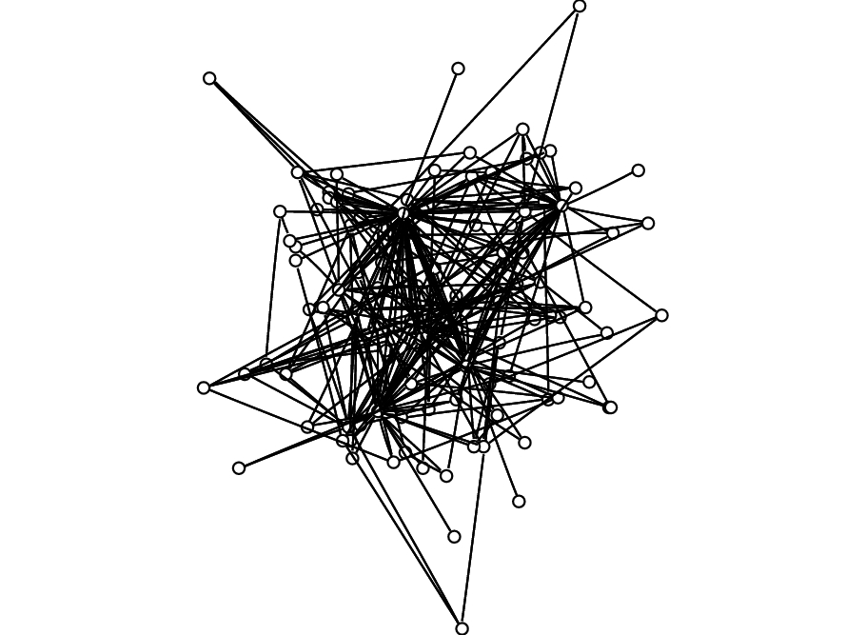
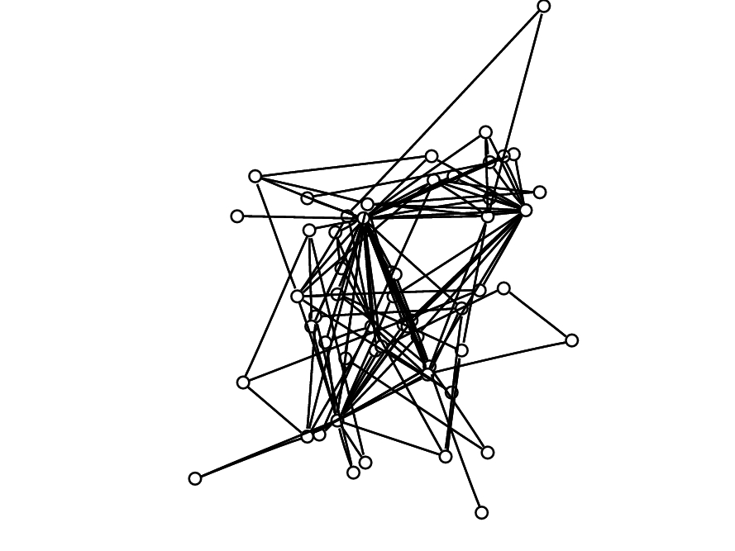
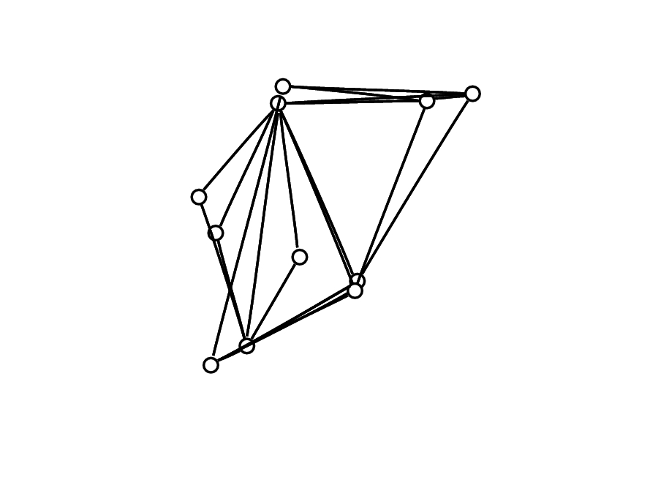
T = 1000
T = 40000
T = 100000
T = 645000
Notes:
25

Slide 26

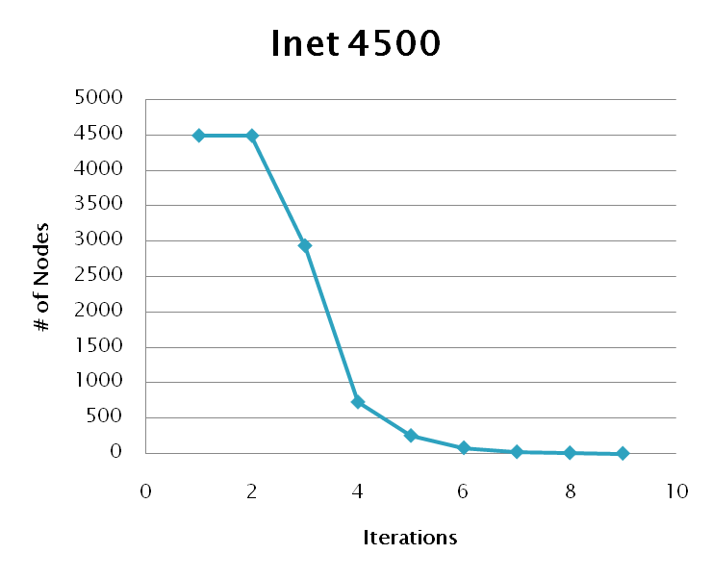
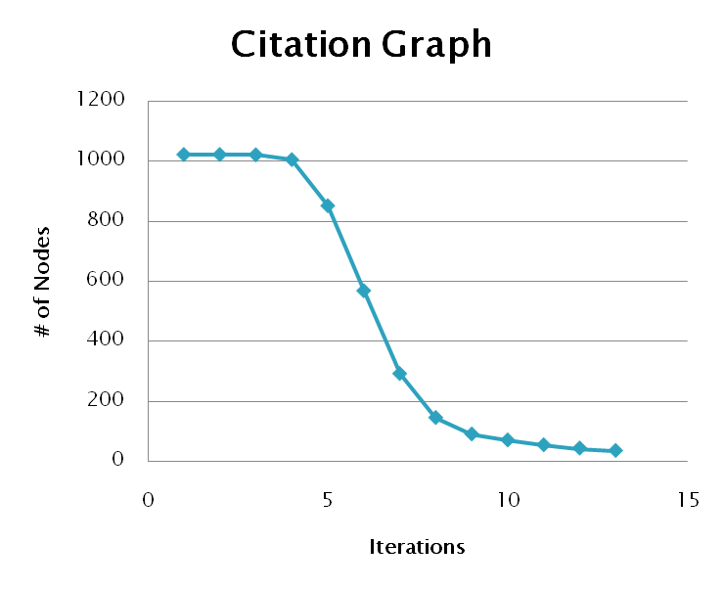
Notes:
26

Slide 27

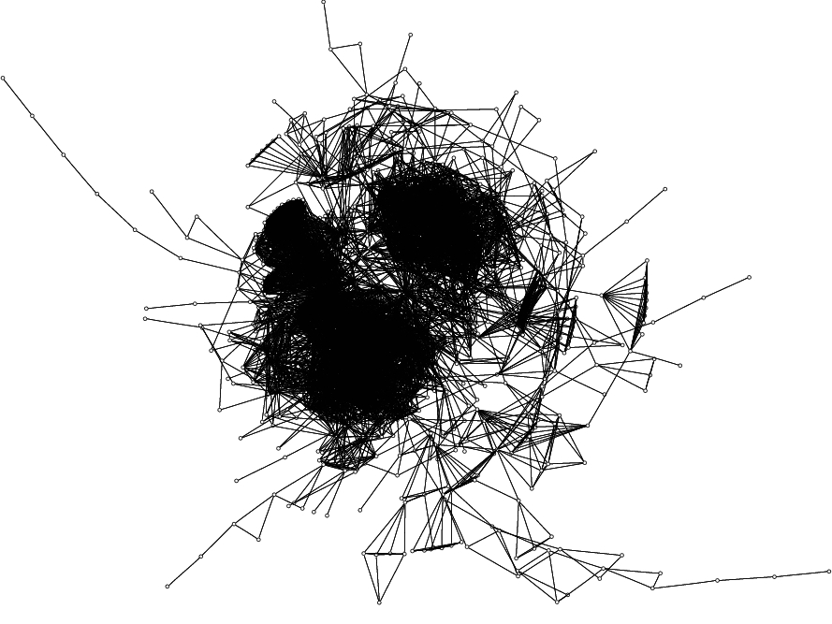
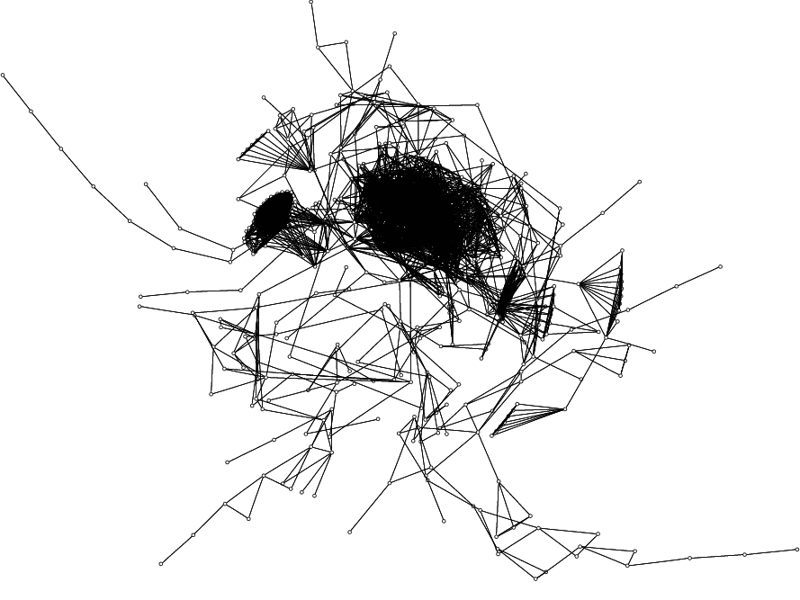
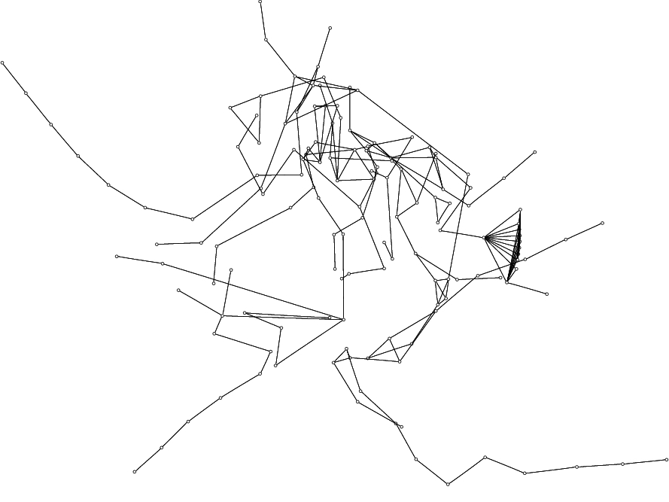
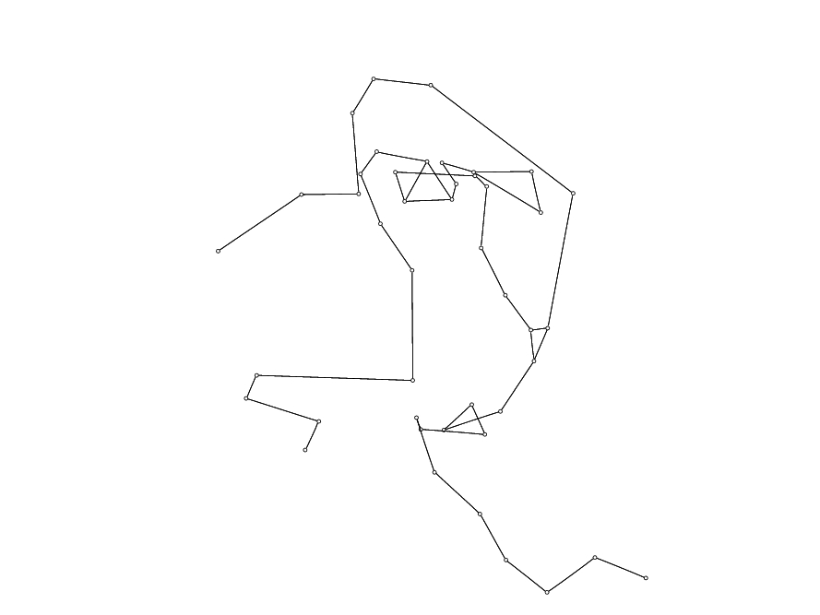
T = 10
T = 13
T = 15
T = 19
27
Notes:
27

Slide 28

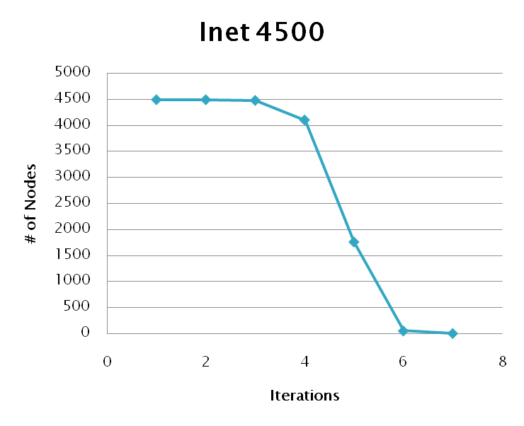
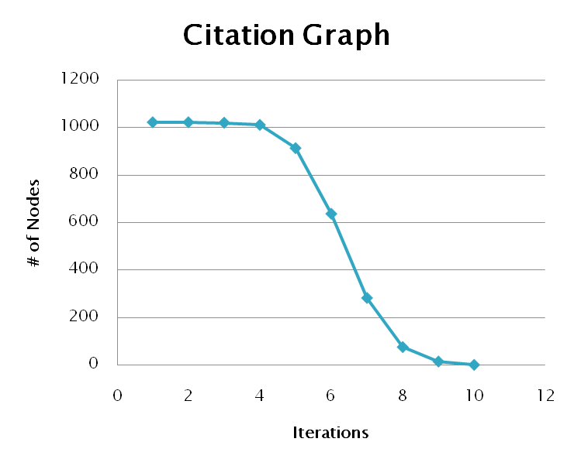
Notes:
28

Slide 29

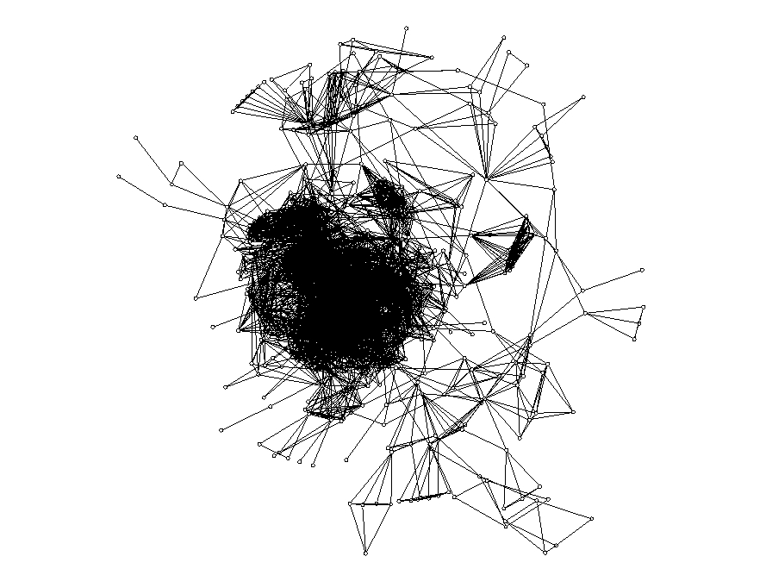
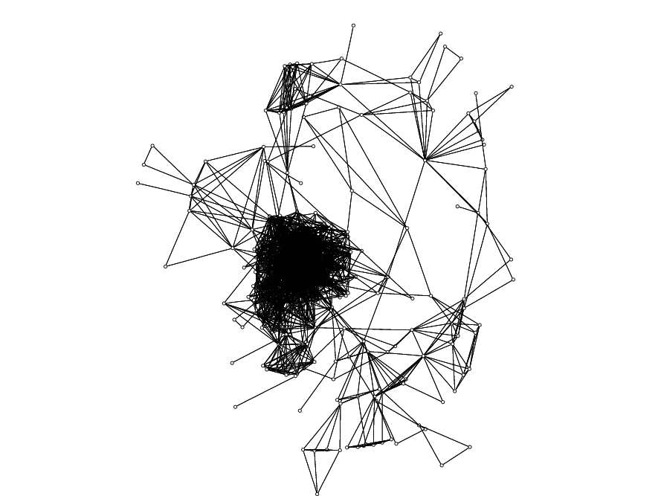
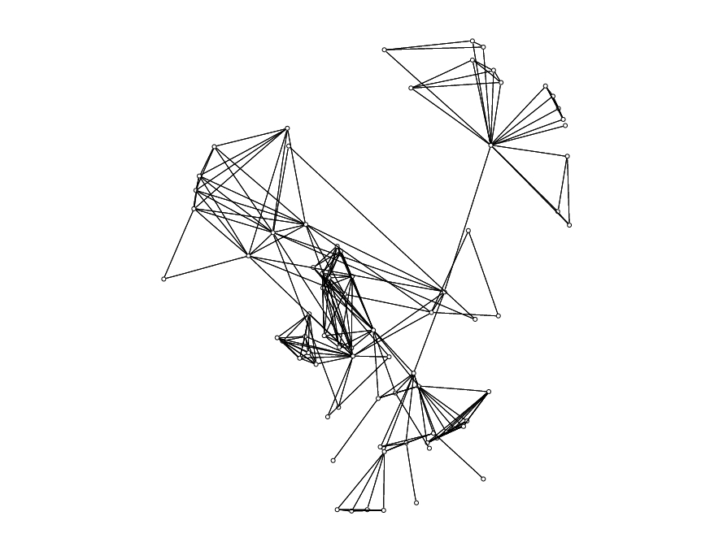
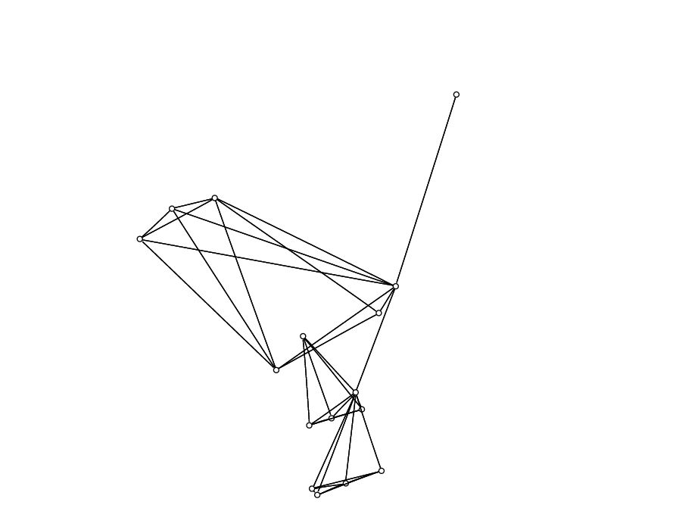
T = 5
T = 6
T = 7
T = 8
Notes:
29

Slide 30

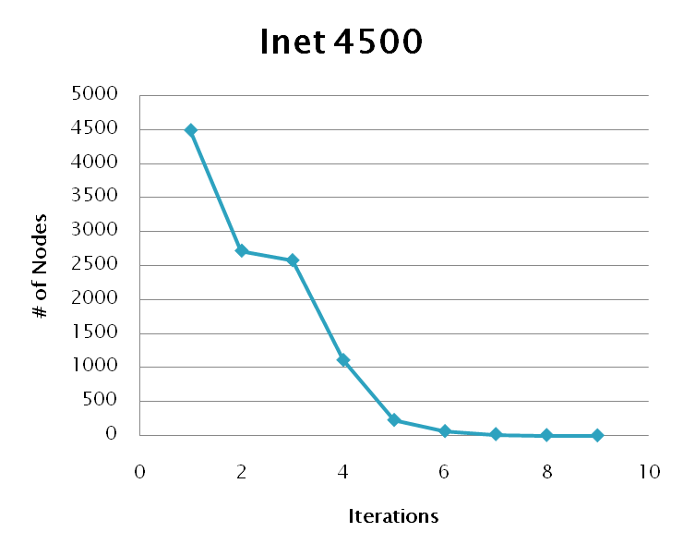
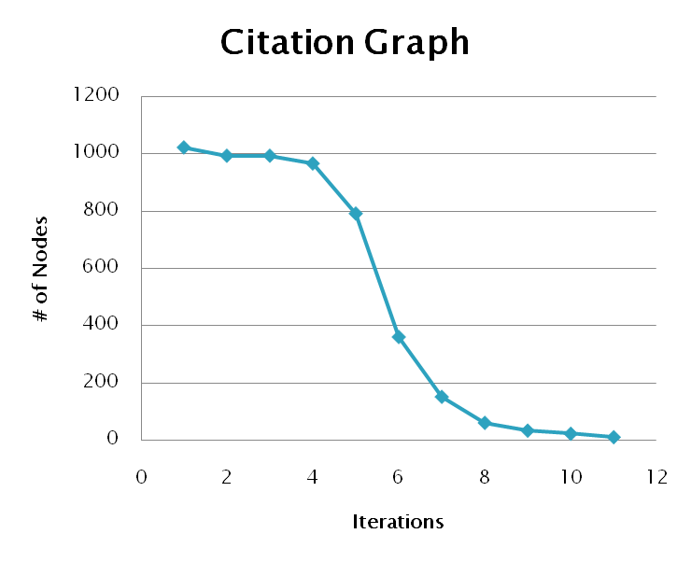
Notes:
30

Slide 31

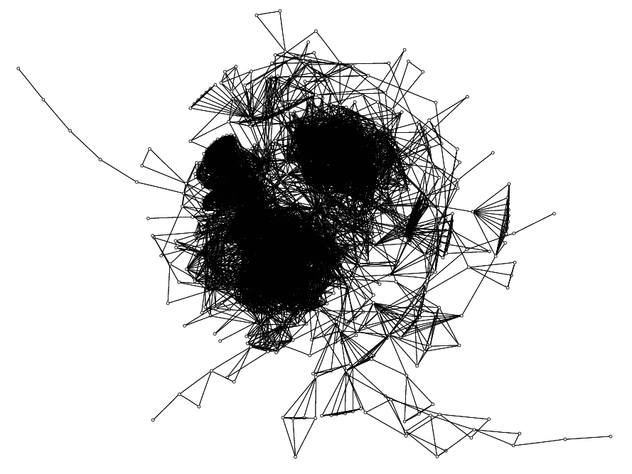
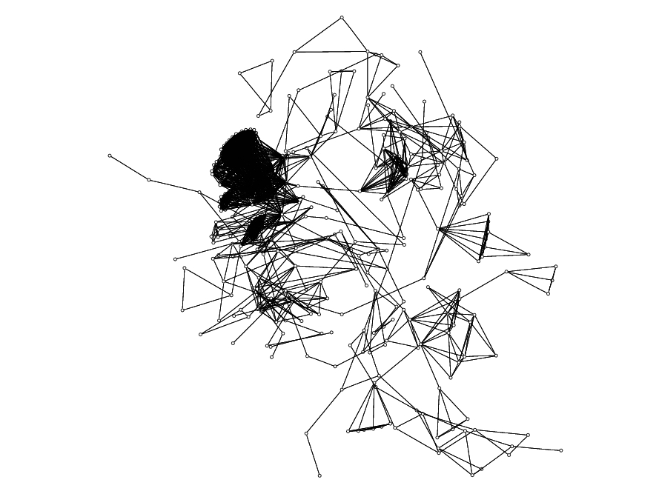
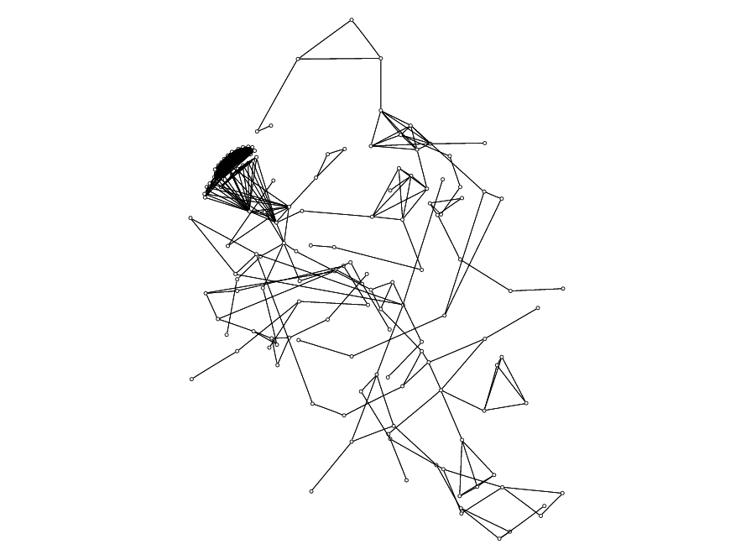
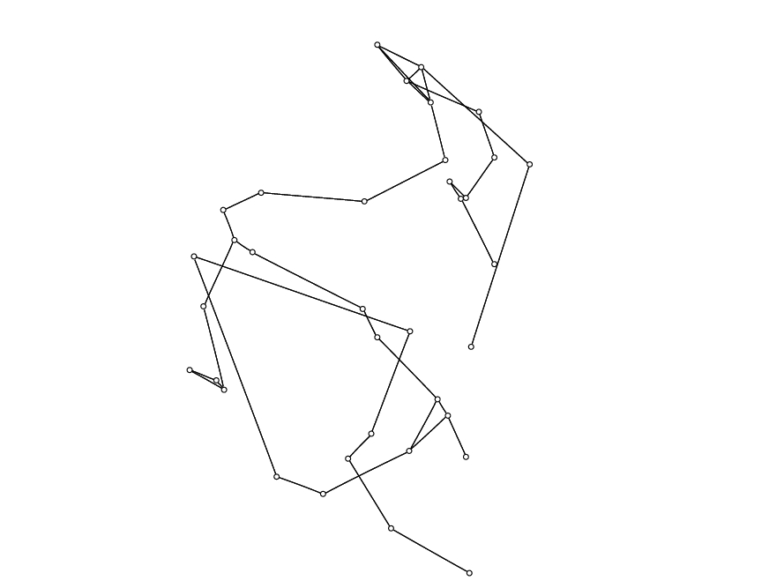
T = 2
T = 5
T = 6
T = 9
Notes:
31

Slide 32

Proposed Method
Shown several weighting metrics
Evaluated performance
Applied metrics to several graphs
Future Work
Define further metrics
Consider more graph types
Notes:
32

Slide 33
GPU Based Algorithms for Spectrum Sensing in Cognitive Radio Networks
Chapter 3

Slide 34
Cognitive Networking & Spectrum Sensing
Background behind cognitive networking and spectrum sensing.
Motivation for improving performance
Use intro and related work from thesis as guide

Slide 35
Why use the GPU?
Discuss hardware architecture differences
How do these differences improve performance
What other factors improve performance

Slide 36
Why use the GPU?

Slide 37
Application to Cognitive Networking

Slide 38
Energy Detection
Describe what energy detectors do
Pros and cons
Types of signals they detect
Other general facts about energy detectors

Slide 39
Energy Detection
Describe the workings of the periodogram based detector

Slide 40
Cyclostationary Spectral Analysis
Describe the basic function of CSA

Slide 41
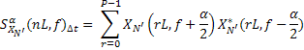
FFT Accumulation Method

Slide 42
Acknowledgements
Dr. Chaomei Chen of Drexel University’s iSchool for providing the citation graph data set.
Alex Fridman of Drexel University’s ECE Department for OMAN research support.
Boris Shishkin of Drexel University’s ECE Department for cognitive networking research support.
U.S Army Communications Electronic Research Development and Engineering Center (CERDEC) under contract # DAAB-07-01-9-L504

